Slide 1
Capstone Engagement
Assessment, Analysis, and Hardening of a Vulnerable System

Slide 2
Table of Contents
This document contains the following sections:
01
Network Topology
02
Red Team: Security Assessment
03
Blue Team: Log Analysis and Attack Characterization
Hardening: Proposed Alarms and Mitigation Strategies
04

Slide 3
Network Topology
‹#›

Slide 4
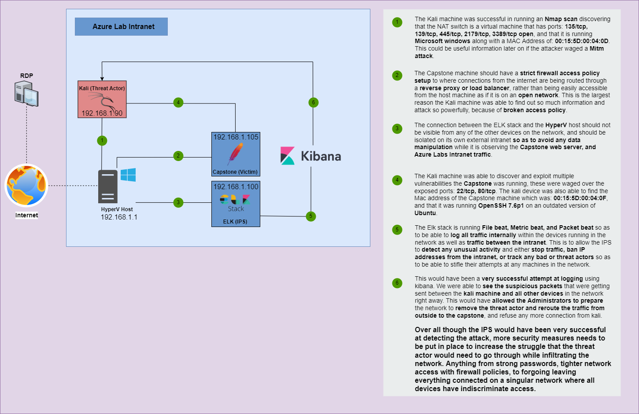
Network Topology
Network
Address Range:
Netmask:
Gateway:
Machines
IPv4: 192.168.1.1
OS: Microsoft
Hostname: HyperV
IPv4: 192.168.1.100
OS: Linux
Hostname: ELK Stack
IPv4: 192.168.1.105
OS: Ubuntu
Hostname: Capstone
IPv4: 192.168.1.90
OS: Kali Linux
Hostname: Kali

Slide 5

Red Team
Security Assessment
‹#›

Slide 6
Recon: Describing the Target
Nmap identified the following hosts on the network:
Hostname | IP Address | Role on Network
ML-REFVM - Microsoft VM Host (00:15:5D:00:04:0D) | 192.168.1.1 | Hosting all the machines and acting as a NAT switch for communication in the virtual network
Kali (00:15:5d:00:04:12) | 192.168.1.90 | Bad actor, Red team machine, performing a penetration test of the network.
Capstone - Apache server machine (00:15:5D:00:04:0F) | 192.168.1.105 | Hosting a business server for the employees to access for customer details.
ELK System (4C:EB:42:D2LD5:D7) | 192.168.1.100 | Monitoring network/file traffic to discover and reduce damage to the infrastructure or mitigate infection.

Slide 7
Vulnerability Assessment
The assessment uncovered the following critical vulnerabilities in the target:
Vulnerability | Description | Impact
CVE-2018-1283 | This server is using HTTP and could have a variable “mod_sessions” configured to forward its session data to a CGI application. | An attacker use a “Session” header to forward its data to CGIs and influence their content allowing for impersonation, and session hijacking.
CVE-2020-13550 | Improper Limitation of a Pathname to a Restricted Directory allowing Path Traversal because of LFI. | This can provide the attacker with more information than they would normally have while navigating the website, and to a bad actor leaked information is leverage/power
UBUNTU-CVE-2019-6111 | Bad actors can arbitrarily overwrite files in the RCP client target directory to use as an IV for further Exploitation. | A vulnerability like this can allow an attacker to host a malicious RCP server (Man-in-The-Middle attack) by waging a directory traversal attack with DIR-buster.
CVE-2020-14145 | The version of OpenSSH allows the client side to have Observable Discrepancy leading to info leaks. | This means SSH sessions can be hijacked where no host key for the server has been cached by the client.

Slide 8
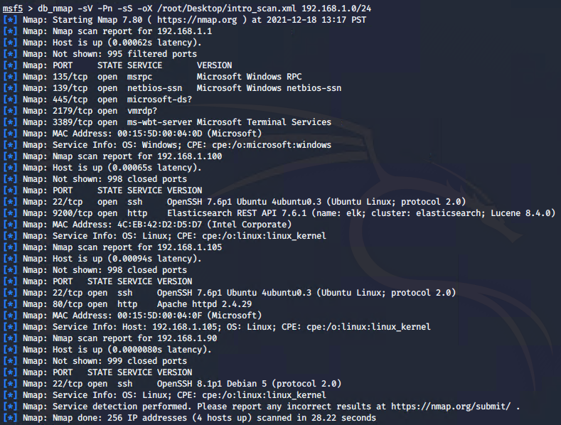
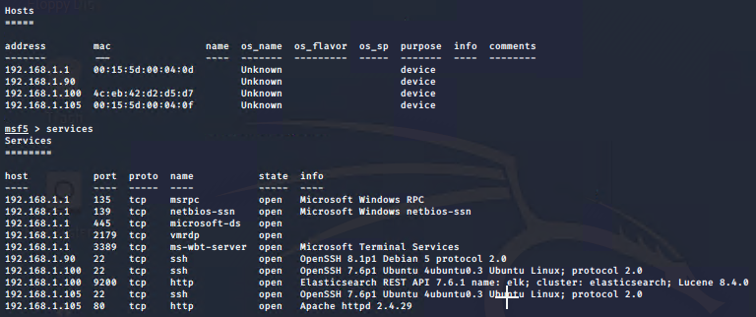
Exploitation: CVE-2018-1283 | outdated HTTP Apache server
01
02
03
Tools & Processes
Used Nmap to discover what ports and services were running on the network, as well the IP and mac addresses the network contained and found an HTTP server that is running with Apache.
Achievements
Once a vulnerable Apache was discovered I had found a hidden directory with dirb, used hydra to brute force because the login contained username info. Once in the directory had held a password hash for another user and mentioned another hidden directory, after cracking the hash with John, I had been able to post a malicious backdoor script using Cadaver with an Admins login credentials that latches to a system service as a super-user.

Slide 9
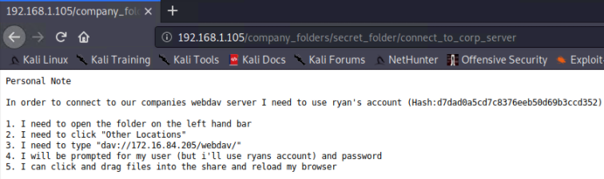
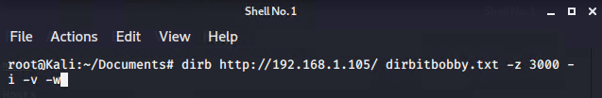
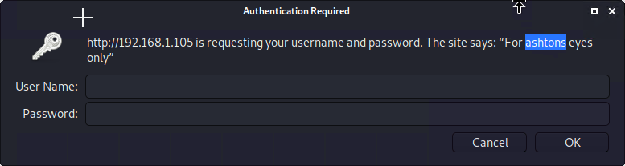
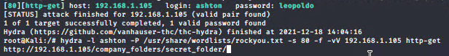
Exploitation: CVE-2020-13550 |
01
02
03
Tools & Processes
After discovering the ports and services that were running and navigating to the apache server that is being hosted on the network, I had used Dir-buster, and hydra to brute force and use directory traversal.
Achievements
Utilizing the information discovered I was able to access more sensitive information to allow myself to access the Username and Password hash of a superuser on the server. With this I knew that I would be able to log in and begin creating a backdoor, injecting a logicbomb or highjack a service to plant a RAT on the system for a Mitm attack.

Slide 10
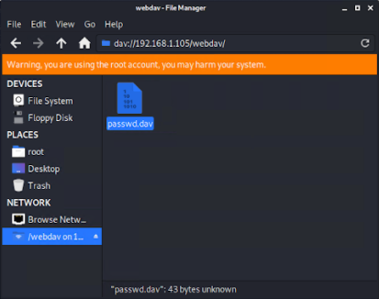
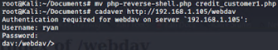
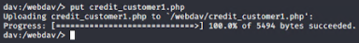
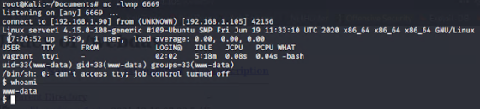
Exploitation: UBUNTU-CVE-2019-6111
01
02
03
Tools & Processes
After gaining access to the server admin account with the credentials and testing them using an SSH tunnel. I had been able to use the payload injector tool Cadaver, to inject a reverse shell php script that I was able to create using the Metasploit Framework built into kali.
Achievements
Exploiting these vulnerability allowed the payload to hijack a service that ran a shell connection from the server machine to my kali device with the credentials of the servers super-user. The kali device had a NetCat listener service running that allowed me to remotely run malicious code to further wage attacks or cover up the ways I attacked the system.

Slide 11

Blue Team
Log Analysis and Attack Characterization
‹#›

Slide 12

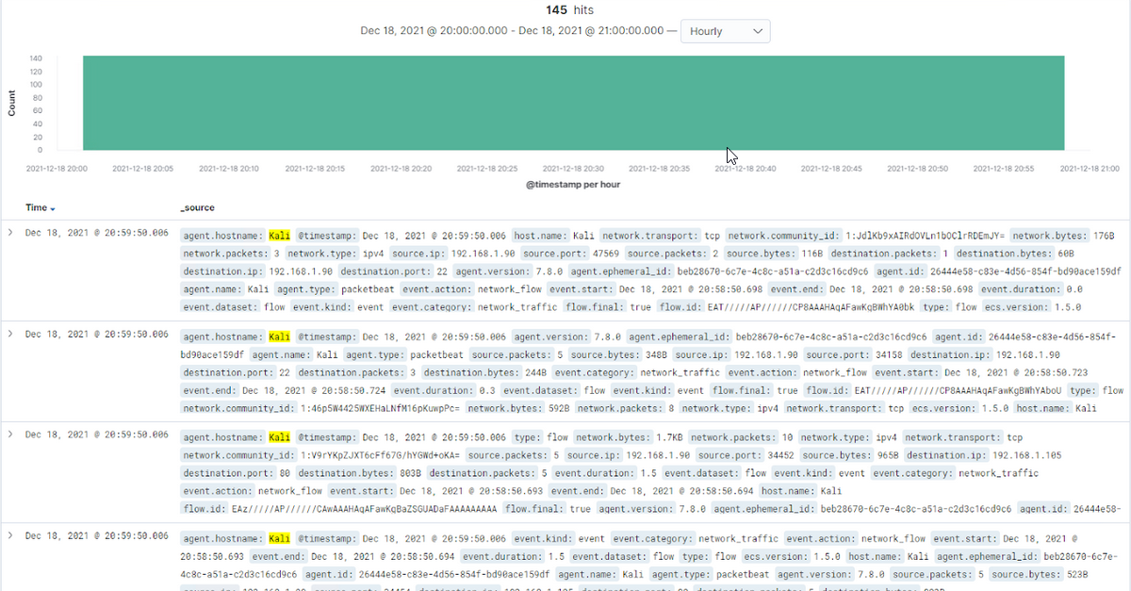
Analysis: Identifying the Port Scan
Answer the following questions in bullet points under the screenshot if space allows. Otherwise, add the answers to speaker notes.
Dec 18, 2021 @ 20:59:50.006
Aprox. 60,313 Packets were sent from 192.168.1.90
The headers of the packets as well as the volume
[Insert Here]
Include a screenshot of Kibana logs depicting the port scan.

Slide 13
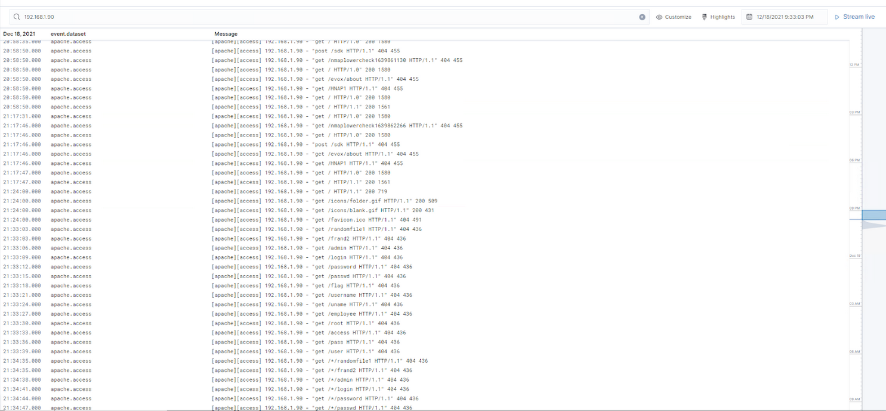
Analysis: Finding the Request for the Hidden Directory
Answer the following questions in bullet points under the screenshot if space allows. Otherwise, add the answers to speaker notes.
20:58:50.000, and there were approximately 200 requests made for the hidden directory
‘/company_folders/secret_folder/’ had an admin password hash.
[Insert Here]
Include a screenshot of Kibana logs depicting the request for the hidden directory.

Slide 14
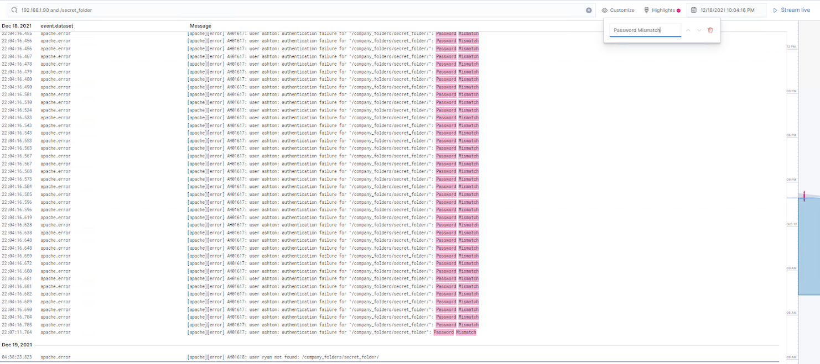
Analysis: Uncovering the Brute Force Attack
Answer the following questions in bullet points under the screenshot if space allows. Otherwise, add the answers to speaker notes.
Log-in attempts with an agent ID of hydra began at 21:42:47.305.
Over 16,400 login attempts occurred before the admin password was found.
[Insert Here]
Include a screenshot of Kibana logs depicting the brute force attack.

Slide 15
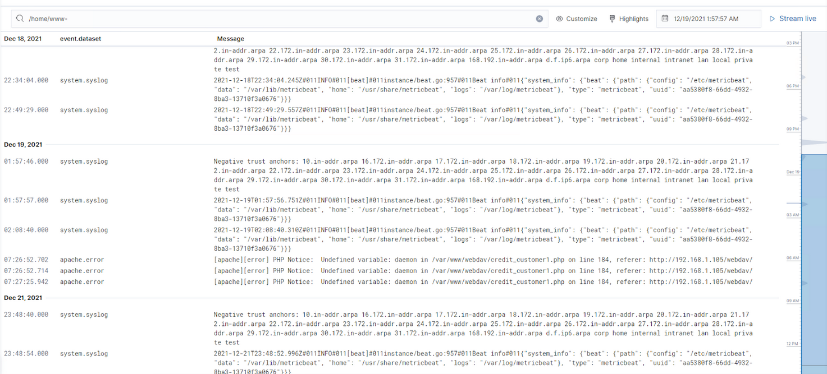
Analysis: Finding the WebDAV Connection
Answer the following questions in bullet points under the screenshot if space allows. Otherwise, add the answers to speaker notes.
After approximately 16 attempts at accessing the /var/www/webdav directory there was injection of a hostile script.
The presumably hostile injected script was /credit_customer1.php.
[Insert Here]
Add a screenshot of Kibana logs depicting the WebDAV connection.

Slide 16
Blue Team
Proposed Alarms and Mitigation Strategies
‹#›

Slide 17
Mitigation: Blocking the Port Scan
To detect future port scans an alarm can be placed to be set off when too many packets are being received within too short of a time frame. Something reasonable can be baselined depending on the expected traffic.
In this case assuming it's just a small company access server for 4 employees having anymore than 300 packets received from any internal IP within a minute will be seen as suspect of a port scan.
In this case because the Server is running Ubuntu you are able to use UFW or Firewalld to configure the proper port access to the server, and ban any ips that are inquiring too intensely.
Installing fail2ban to use with UFW is a great option:
$ sudo apt-get -y install ufw fail2ban
$ sudo sed -i 's/IPV6=no/IPV6=yes/g' /etc/default/ufw
$ sudo ufw allow ssh
$ sudo ufw default deny incoming
$ sudo ufw default allow outgoing
$ sudo ufw logging low
$ sudo ufw reload

Slide 18
Mitigation: Finding the Request for the Hidden Directory
You can set an alarm to make it so that if a user is attempting to access a directory without the proper rsa key, or even with the correct key, if they are trying to access the directory during a strange time at night, while business is closed.
Anymore than 35 attempts at a hidden directory within an hour or anymore than 5 made without proper credentials then it will set off an alert.
There are plenty of different ways to require further authorization for specific directories on a hosted server, one of the most commonly used way would be to assign each users unique device on the network with a Windows SecurID, this will allow you to know when a specific device is being used to access the server files allowing for the formulation of a proper baseline for suspicious activity after a certain time of day.

Slide 19
Mitigation: Preventing Brute Force Attacks
This would heavily depend on volume of users attempting to access the folders and the server, but assigning a user lockout, and password lock after too many attempts will likely mitigate brute forcing.
If a user fails to login to access a network directory more than 10 times in 30 seconds then denying any future login attempts for 5 minutes, and then after 10 more failed attempts to login force the user to contact admin to reset the password lockout.
Enforcing a stronger password policy with a minimum complexity as well as an expiration time frame for the users passwords that will keep them fresh, without making the users create weak iterations of previous passwords.
This can be set in group policy in windows, but in Ubuntu you can make it so that the openSSH server enforces a password expiration as well as a renewal of keys after a certain time frame.

Slide 20
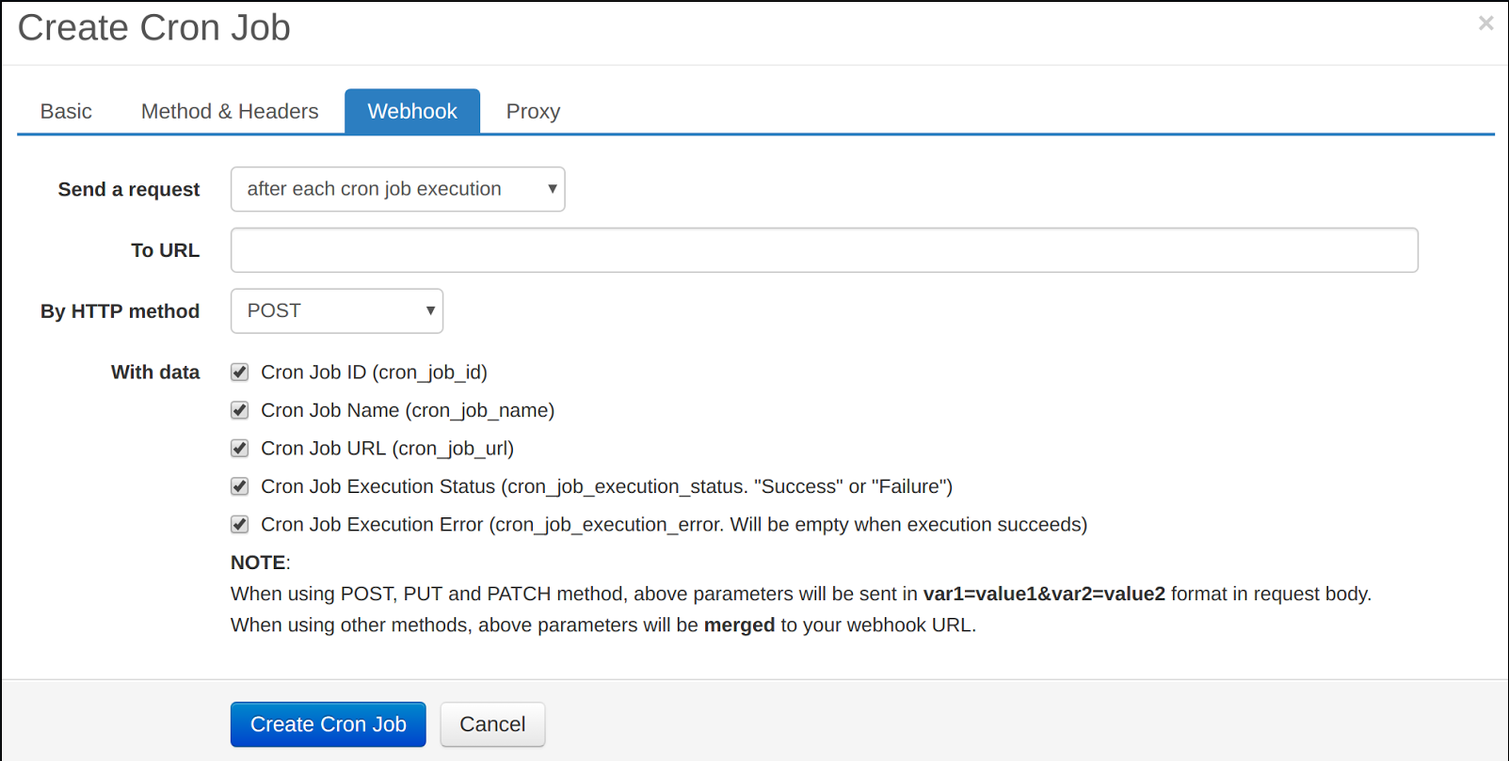
Mitigation: Detecting the WebDAV Connection
You can set an alarm by emailing an alert through the use of a webhook or a message to journeld and/or a cronjob that states a certain user had attempted access, or successfully accessed a WebDAV connection outside of a specified time frame, even if they are an administrator, this will likely inform them that someone has their login credentials.
Any logins made after 11PM until 5AM or during scheduled maintenance, sends an alert of a login to make system changes.
Assigning an easycron job to send a post to a webhook, when there is any system access logins made outside of expected work time frames, to alert any system admins that their credentials are being used without them knowing.

Slide 21
Mitigation: Identifying Reverse Shell Uploads
Creating an alert of any time the tool ‘netcat’ is being used on a system, or a connection is being made on an unknown port with a service that normally has predictable connections within the network.
Any time netcat or other network utility tools are being used from any services that normally doesn’t have access to advanced networking capabilities will trigger an alarm.
Enforcing a strict set of upload policies for the servers firewall is a surefire way to make it so that an attacker would need to go through even more great lengths to upload a shell to a devices listening for the connection on a specific port.
Creating an egress filtering Policy to drop or reset any connections that uploads are being attempted on ‘unnecessary’ ports is the safest bet to preventing or stifling a reverse shell from being opened in the case of malicious scripts being executed.

